Slide 1
The Oklahoma Office of Family Representation Phased Rollout
The Family Representation Advocacy Act, 10 O.S. § 801 et seq., established the Family Representation Advocacy Program within the Administrative Office of the Courts and the AOC has contracted with Legal Aid Services of Oklahoma to bring the OFR to life.
Gwendolyn Clegg
Director, Oklahoma Office of Family Representation
Legal Aid Services of Oklahoma

Slide 2
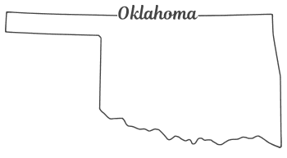
Timeline for the Oklahoma Office of Family Representation :
January 2023
Legislation Introduced for a Statewide Central Office for Parent and Child Representation to include interdisciplinary rep
2 June 2023
Statewide Central office of Parent and Child Legal Rep became law called the “Family Representation and Advocacy Act” effective November 1, 2023. 10 O.S. Section 801
January 2024
1 July 2024
AOC signed a contract with LASO to be the Vendor to build the “Oklahoma Office of Family Representation”
Region 5 = 9 NE OK Counties Region 2 = 21 SW OK Counties fully rolled out
1 July 2025
Region 1 = 25 NW OK Counties
Region 3 = 1 OK County
Region 4 = 21 SE OK Counties

Slide 3
Family Representation Advocacy Act & Program
The PURPOSE of the Family Representation and Advocacy Program shall be to ensure uniform and high quality legal representation for children and indigent parents, legal guardians, and Indian custodians in deprived child actions brought by the state pursuant to Oklahoma’s Children Code.
Oklahoma Statues, Title 10 Section 801(C).

Slide 4
Family Representation Advocacy Program
the Administrative Office of the Court shall issue a RFP (August 29, 2023);
Contract with an eligible organization (on-going);
Administer the Family Representation and Advocacy Program;
Establish a central office for the state of Oklahoma:
Known as the Oklahoma Office of Family Representation
Oklahoma Statues, Title 10 Section 801(D).
***January 24, 2024, AOC signed a contract for LASO to be the Vendor to set up the FRAP***

Slide 5
Service Delivery Schedule is by DHS Region OFR covers ALL 77 Oklahoma Counties Applies only to Juvenile Deprived Court Cases
Full rollout July 1, 2025:
DHS Region 5 = counties - Osage and Pawnee
DHS Region 4 = counties – Adair, Atoka, Bryan, Cherokee, Choctaw, Coal, Haskell, Hughes, Latimer, LeFlore, McCurtain, McIntosh, Muskogee, Okfuskee, Okmulgee, Pittsburgh, Pontotoc, Pushmataha, Seminole, Sequoyah, and Wagoner.
DHS Region 3 = county – Oklahoma*
DHS Region 1 = counties – Alfalfa, Beaver, Beckham, Blaine, Canadian, Cimarron, Custer, Dewey, Ellis, Garfield, Grant, Harper, Kay, Kingfisher, Logan, Major, Noble, Payne, Roger Mills, Texas, Washita, Woods, and Woodward.
*“The existing Offices of Public Defender shall continue to provide representation for children in deprived child proceedings and continue to be funded as set forth in Section 138.4 of Title 19 of the Oklahoma Statutes.” Oklahoma Statues, Title 10 Section 801(G).

Slide 6
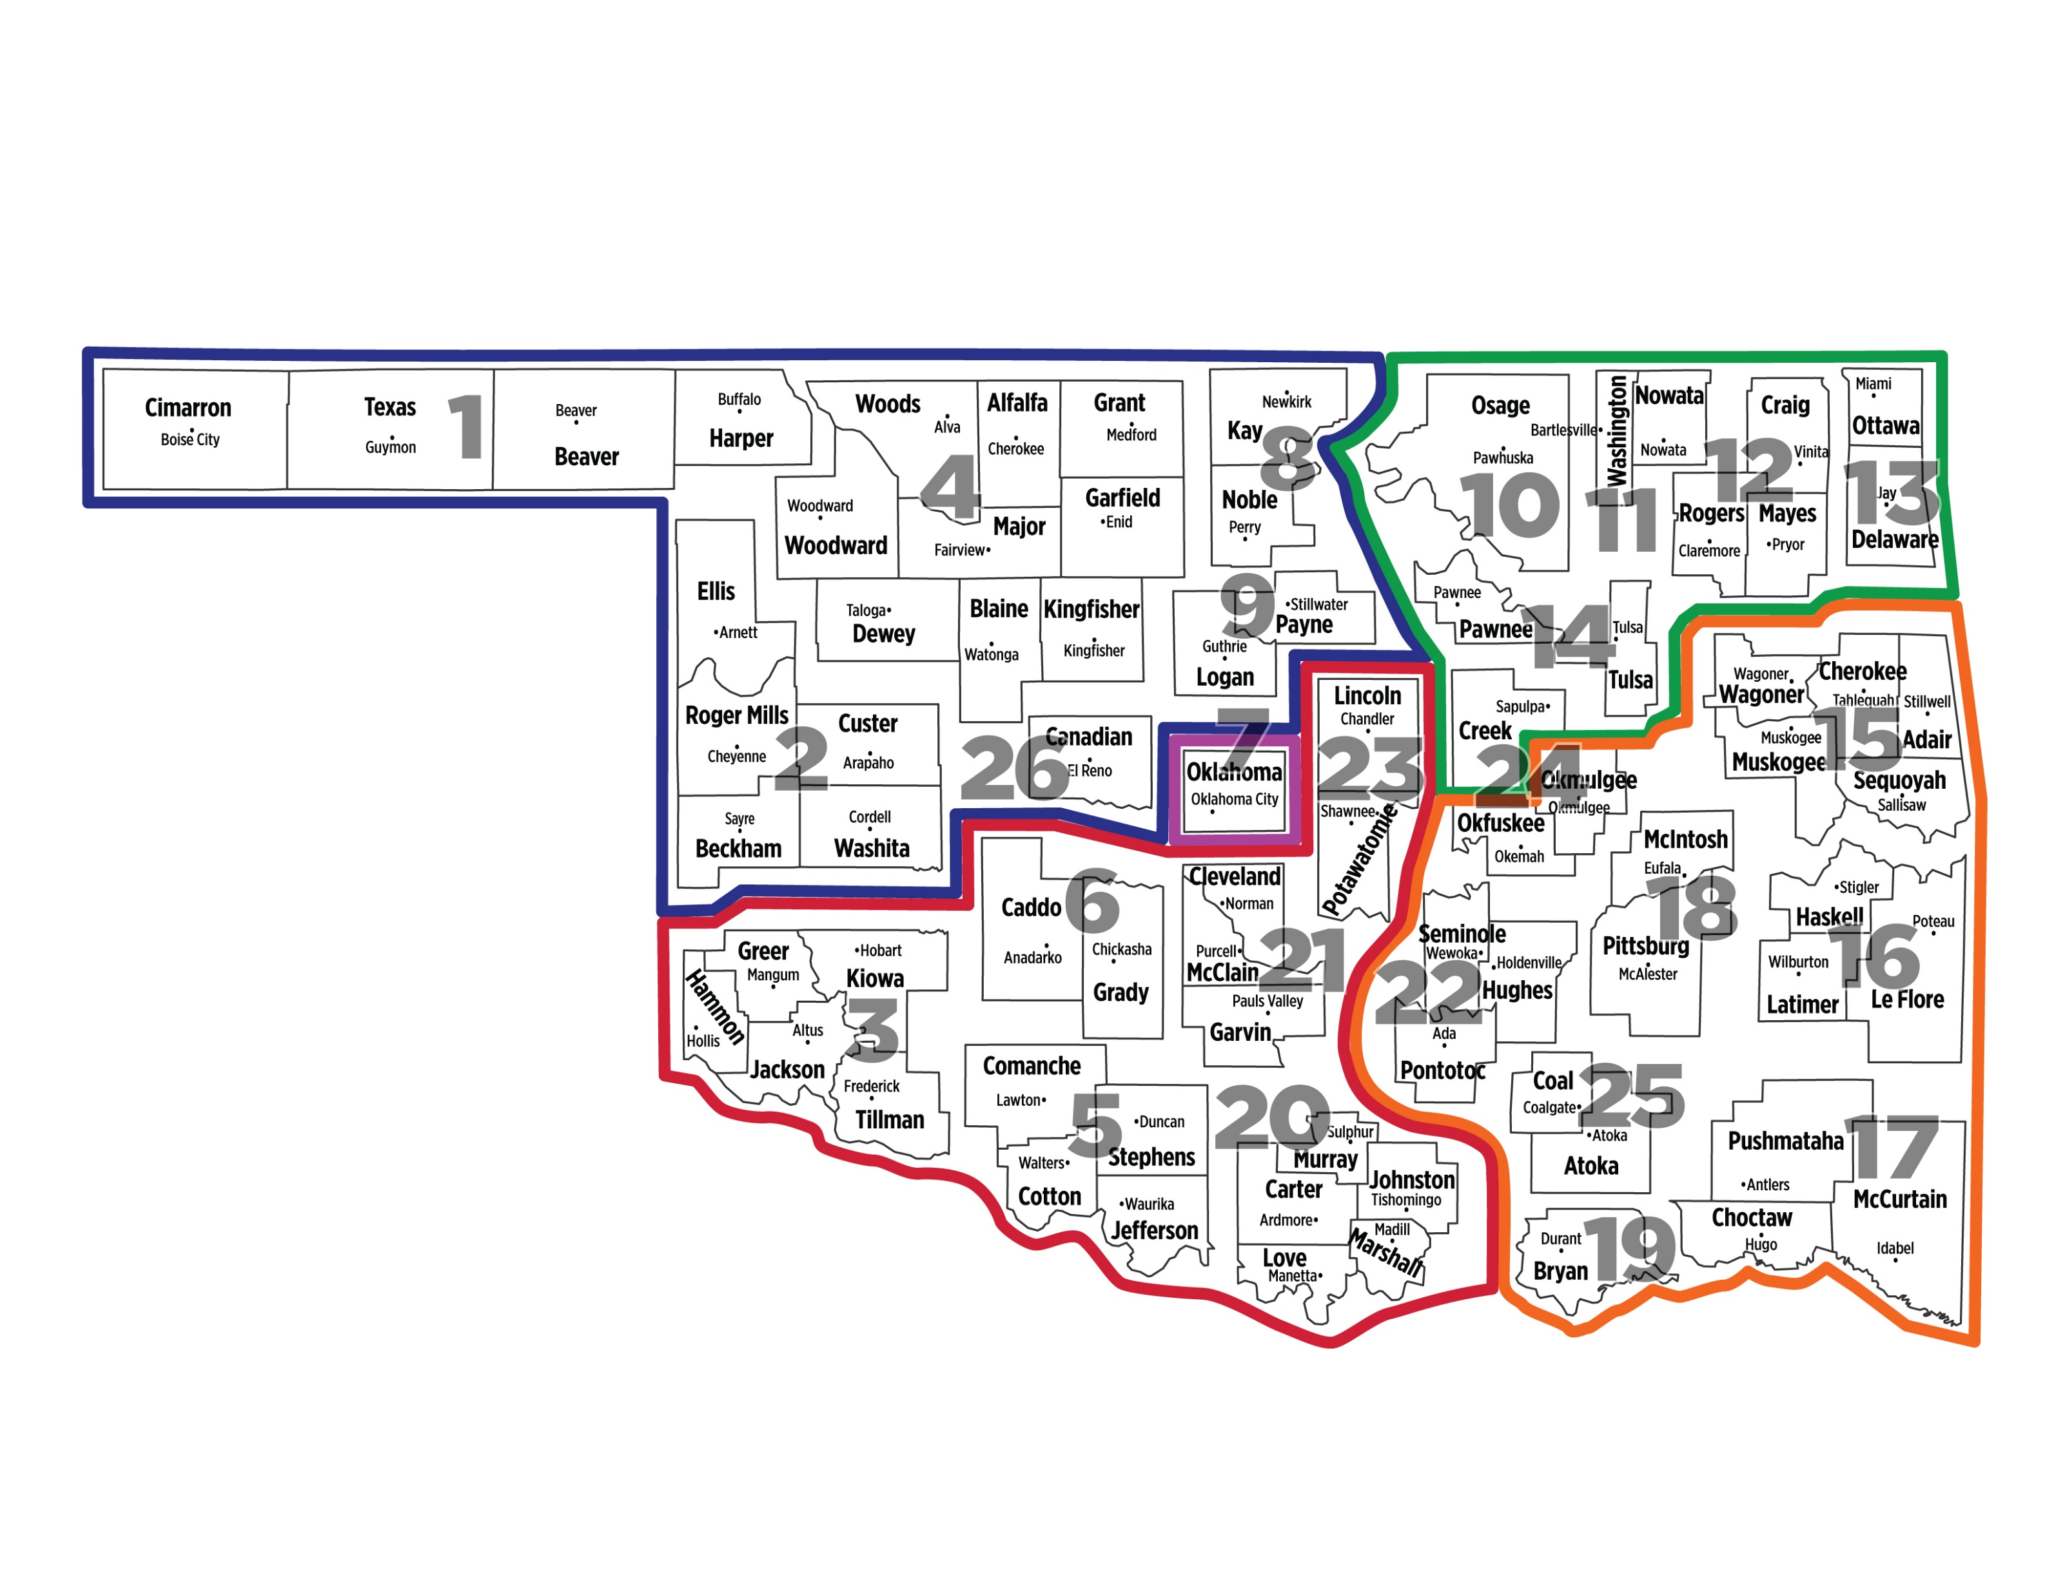
MAP
DHS Region 1 – Blue
NW OK
DHS Region 2- Red
SW OK
DHS Region 3 – Lavender
OK CO
DHS Region 4 – Orange
SE OK
DHS Region 5 – Green
NE OK

Slide 7
Staffing Plan

Slide 8
Each Managing Attorney (“MA”) shall be responsible to:
recruit, retain, train, oversee and support the attorney contractors
develop resources including brief and motions bank, state case law bank, federal materials, secondary sources, law review articles, and deprived legal representation news
provide case consultations on trial and appellate strategy
provide relevant trainings
provide oversight and annual performance reviews annually
Each Director of Social Work (“DSW”) shall be responsible to:
recruit, retain, train, oversee, and support the social workers and parent/youth mentor contractors
develop resources including assessments, knowledge of community providers, IDT practice, supervision
relevant training for the contractors
provide consultations on case strategy
provide oversight and annual performance reviews annually
Per statute: OFR staff will NOT have any direct client contact nor provide direct client representation.

Slide 9
Recruitment and Retention of Attorney contractors:
OFR will facilitate continuity of representation under prior attorney contracts when and where feasible and make every attempt to contract with current, former or new counsel.
*Not everyone who has contract now with the District Court will automatically receive a contract with OFR. Factors include performance, representation needs and appropriations.
OFR may contract with any type of legal entity including law firms, legal services programs, Office of Public Defender, law school clinics, and individual attorneys.

Slide 10
Compensation Attorney and Interdisciplinary Contractor:
Trial attorney contractors shall be compensated via
a contract with OFR
Attorney chooses primary and conflict counties
OFR’s max caseload cap is eighty (80) cases/clients per statute
$8,000 a month/60 - 80 cases
$6000 a month/40-60 cases
$4000 a month/20-40 cases
Less than 20 cases is TBD
Appellate attorney contractors shall be compensated via
a contract with OFR
$2,250 per appeal, caseload cap of 8 open and active appeals
paid upon submission of invoice at the conclusion of the appeal, i.e. after last brief filed.
Social worker and mentor contractors shall be compensated via
a contract with OFR
hourly wage each working 120 hours a month
***Independent contractors remain responsible for all administrative, office, and overhead expenses associated with representation.

Slide 11
To Apply For OFR Staff positions:
Go to LASO’s website at LegalaidOK.org/employment/
Oklahoma Office of Family Representation (OFR):
Regional Managing Attorney – Job Description
Managing Attorney of Appellate Practice – Job Description

Slide 12
Judicial Input on Attorney Contractors:
OFR Staff will meet virtually with the Judiciary in each Region to gain their insight:
On recommendations for attorney contractors,
If a Judge is satisfied with current attorneys – those attorneys will need to go to the OFR website, select their Region and fill out the form to indicate their interest in contracting with OFR.
OFR is responsible for the compensation, training, and oversight of the attorneys.
Compliments and complaints about contractors are welcomed. Go to the OFR website and click the compliment/complaint button on the home screen.
www.oklahomafamilyrepresentation.org

Slide 13
Court’s will appoint OFR contract attorneys to represent parents and children:
OFR will provide Judges with
A Bench Card with the list of TRIAL attorneys
to appoint to represent parents and children in the trial court
If an attorney has a conflict, the attorney shall ask to withdraw. Then the Court may appoint another attorney from the list.
Regional MA’s will assign APPELLATE Counsel to perfect appeals.
Trial Counsel will notify their Regional MA of the entry of final Order and that a party has requested an appeal.
The Court will enter one Order (1) Appointing LASO, (2) Finding the Party Indigent, (3) Ordering the Transcript to be transcribed at public expense and; (4) Payment to be made to the court reporter from the court fund. All-in-One Appellate Order will be provided.

Slide 14
Attorney Caseload:
The MA’s for each Region will closely monitor the contract attorneys’ caseload via case management software - LegalServer
The attorneys are responsible for entering the required case data into the case management software. (18 data points)
The Regional MA will notify the Court when a contract attorney is close to reaching their maximum caseload cap;
The Regional MA will ask the Court to stop appointing that attorney to new cases until the attorney’s caseload reduces.
OFR respectfully asks the Court to equitably appoint all the attorneys on the Bench Card to cases.

Slide 15
What are interdisciplinary teams, how are they assigned and how do they work?
Interdisciplinary Team = Attorney, a Social Worker and/or a Mentor working together to address the conditions that brought the children into custody.
All team members operate under the attorney’s confidentiality, work product and privilege as non-lawyer assistants. ORPC Rule 5.3 - Responsibilities Regarding Non-lawyer Assistants.
Interdisciplinary teams are assigned by the Regional DSW at the request of the attorney.
The parent and child attorneys shall request an interdisciplinary team, at the earliest possible moment, ideally after the Emergency Custody Hearing but no later than the Dispositional hearing.
Teams work with clients identifying client’s strengths and needs.
The Team uses out-of-court advocacy to (1) gather information, (2) increase communication, (3) advocate for the client in and out of court; and (4) the mentors are key to the engagement of clients.
From the information gathered the attorney is equipped with more information to provide the Court.
*Not all clients need an interdisciplinary team.

Slide 16
Training
OFR will provide and coordinate high-quality training with:
Oklahoma’s Court Improvement Program
Oklahoma Bar Association – Juvenile Law Section
Local Bar Associations - monthly CLE or TCBA’s Juvenile Law Day
Other relevant state and national organizations i.e. ABA Center on Children and the Law, ABA National Association of Parent Representation Steering Committee, National Association of Counsel for Children, Family Justice Initiative, HARUV USA,
OFR will ensure all attorney contractors comply with the OK Standards of Practice for Attorneys Representing Parents and Children in Deprived Proceedings. O.S. Title 10 § 801 (h).
Attorneys must provide proof of the required 6 hours of annual relevant CLE for a OFR contract. O.S. Title 10A § 1-8-101.

Slide 17
QUESTIONS
gwendolyn.clegg@laok.org
Director
Oklahoma Office of Family Representation
Legal Aid Services of Oklahoma, Inc.
907 S. Detroit Ave, Suite 1001
Tulsa, OK 74120
918.319.2454

